Slide 1
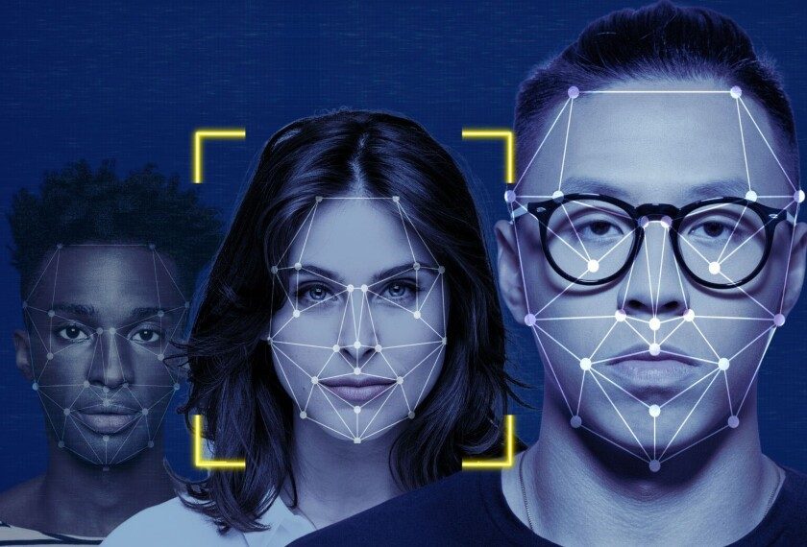
Gender Classification Using Facial Recognition
CSci 158 – Spring 2025
Presented by: Darpan Attri & Harika Yendapalli
Date: 05/06/2025
Notes:
“Hey everyone, I’m Darpan Attri, and I’m here with Harika Yendapalli. Today we’re going to talk about something that’s both really cool and surprisingly complex — using facial recognition to predict gender. We’ve looked at how different methods work, from traditional techniques like PCA and LDA to newer stuff like deep learning. So let’s jump into it.”

Slide 2
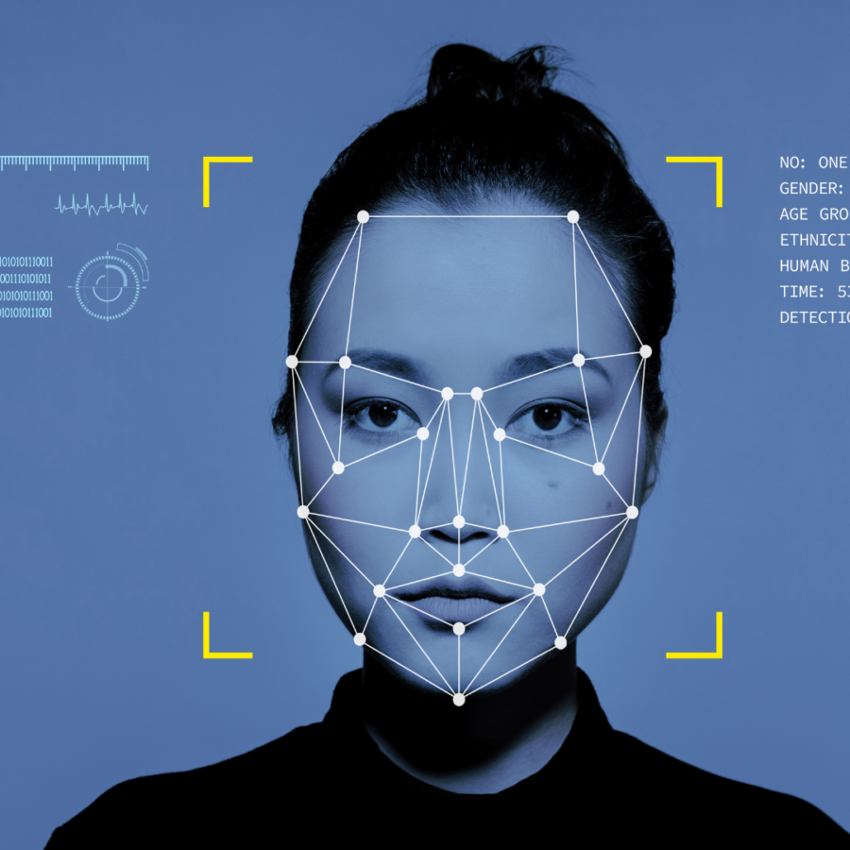
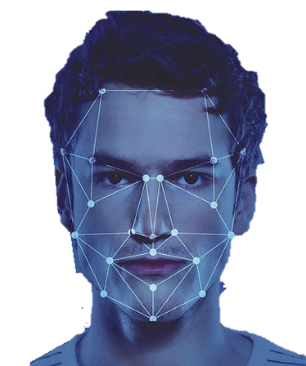
Introduction to Gender Classification
Predict gender from facial images
Non-invasive biometric method
Used in security, ads, analytics
Fast, contactless, and scalable
Notes:
“So why even bother with gender classification? Well, it’s used in tons of places — from security systems to targeted advertising to understanding audience demographics. It’s non-invasive, quick, and works with just a face image. But it’s not as easy as it sounds. Lighting, face angle, even someone’s age can throw the system off. That’s why we explored different approaches to figure out what works best.”

Slide 3
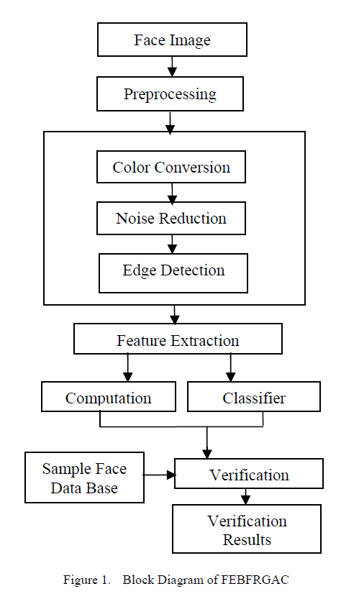
How Facial Recognition Works?
PCA & LDA comes under Feature Extraction
k-NN comes under Classifier
Notes:
“Here’s the general flow: We start with a face image, clean it through preprocessing, and then extract important features using PCA and LDA. These features are passed to a classifier — in our case, k-NN — to predict the gender.

Slide 4
CLASSICAL TECHNIQUES
01
02
03
04
PCA reduces image dimensionality
LDA improves gender class separation
k-NN used for simple, fast classification
Suitable for small datasets and fast systems
Notes:
“Diving into these a little more — PCA, or Principal Component Analysis, helps reduce the size of our data while keeping the important stuff. It’s like compressing an image without losing quality. Then LDA, or Linear Discriminant Analysis, figures out what actually separates male and female faces.. And k-NN? which compares the input face with previously labeled faces to predict gender. These three work really well together and are pretty easy to implement.”

Slide 5
PCA + LDA improve feature separation
k-NN works well on reduced data
COMBINED CLASSICAL METHODS
Used together for interpretable accuracy
Applied in FERET and other benchmark datasets
Notes:
“And when we combine them — PCA followed by LDA, then k-NN — we get a pipeline that’s super efficient and surprisingly accurate. In the papers we looked at, this combo hit 90 to 94% accuracy, especially on datasets like FERET. We also tested it ourselves on a balanced dataset of 100 images — 50 male, 50 female — and the results were solid. It’s a great setup when you don’t have a lot of computing power.”

Slide 6
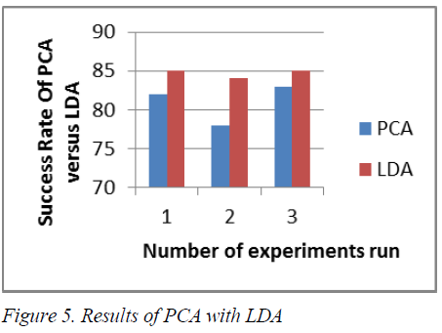

Slide 7
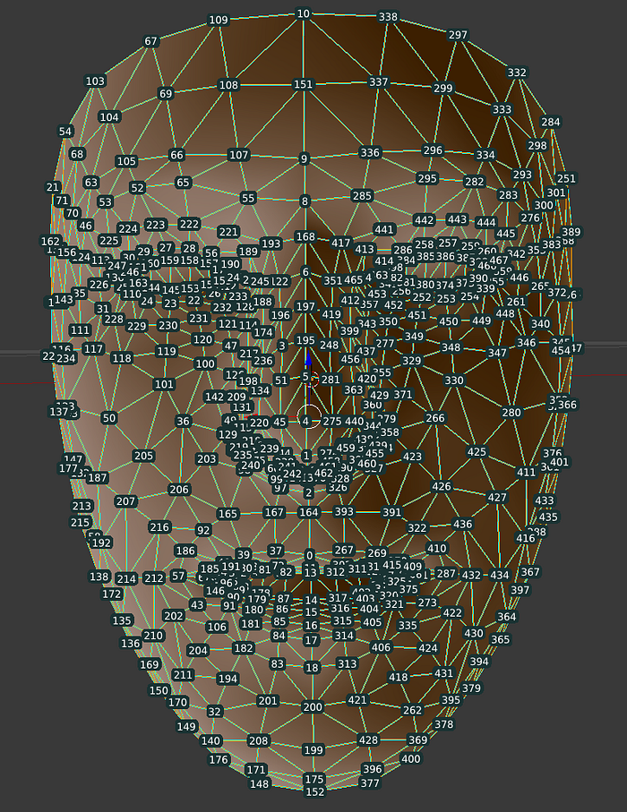
Edge and Geometry-Based Recognition
Uses facial landmarks & edges
Neural networks built on geometric features
Effective with limited data
Good for structured environments
Notes:
“Another approach is to use the actual shape of the face — things like distances between the eyes or the outline of the jaw. These geometry-based techniques can work really well in controlled environments where lighting and pose don’t change much. But they need precise detection of facial points, so they’re a bit sensitive — like, if someone’s face is slightly turned or partially covered, the accuracy can drop.”

Slide 8
Texture-Based Techniques – LBP & LPQ
LBP & LPQ capture micro-texture info
Robust to lighting variation
Useful in real-world scenes (IoG)
Enhances feature richness at low cost
LBP - Local Binary Patterns
LPQ - Local Phase Quantization
Notes:
“Texture-based techniques offer a different approach. LBP, or Local Binary Patterns, and LPQ, Local Phase Quantization, focus on subtle skin textures — like wrinkles or fine lines — that can vary between genders.”
“These methods are lightweight and fast, and work well even with smaller datasets. What makes LPQ stand out is its robustness to lighting variations, which is really helpful in real-world conditions.”
“When combined with PCA or LDA, they add an extra layer of detail that can boost classification accuracy without increasing complexity too much.”

Slide 9
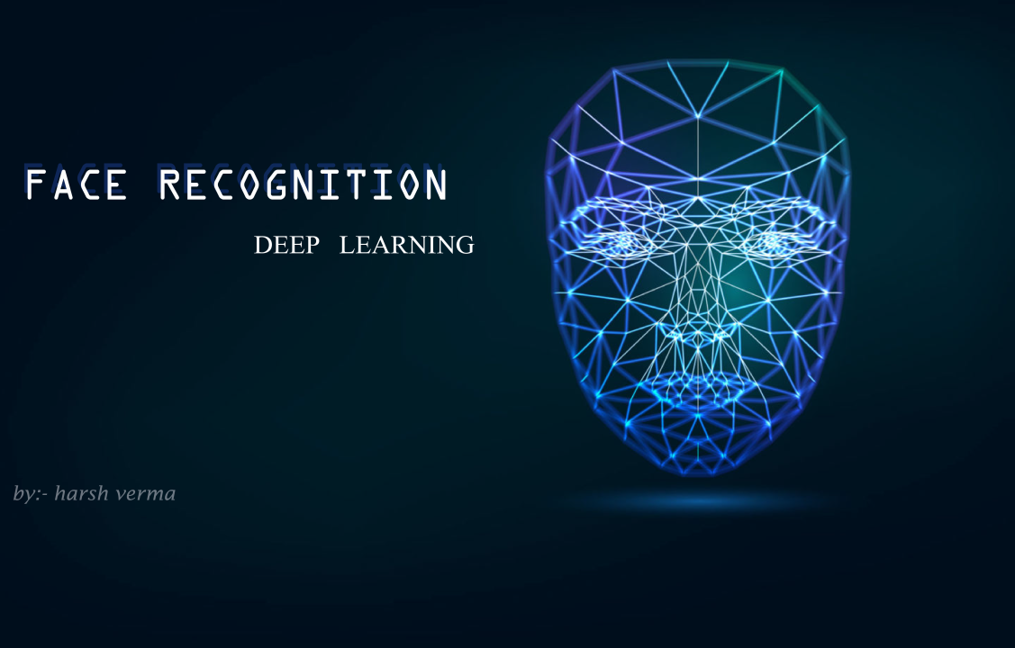
Deep Learning with CNNs
CNNs: VGGNet, GoogLeNet, AlexNet
High accuracy on large datasets (IMDB, FER)
Learn hierarchical features automatically
Need high compute and large data
Notes:
“Then we have deep learning — and this is where things get powerful. CNNs like VGGNet or AlexNet don’t need you to hand-pick features — they learn everything from the data. They’re insanely accurate — up to 98% on datasets like IMDB-WIKI — but the downside is that they need tons of data and a good GPU to run well. So while they’re great for large-scale systems, they’re not always practical for smaller or real-time applications.”

Slide 10
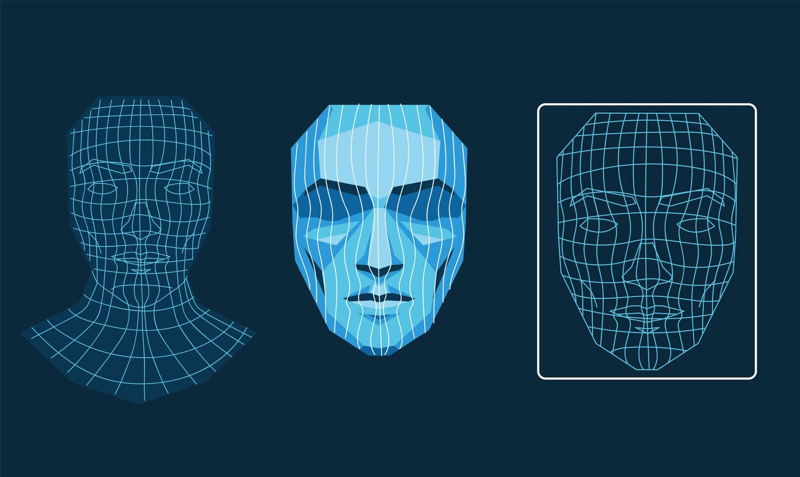
Hybrid and 3D Approaches
Combine 2D + 3D features
Radon transform with PCA & LDA
Better against pose/lighting issues
Higher accuracy but computationally heavy
Notes:
“Some researchers are combining 2D textures with 3D geometry to get the best of both worlds. Others use the Radon transform, which helps with things like rotation and pose variation. These hybrid models are more accurate in messy, real-world scenarios — but yeah, they’re also heavier and harder to run on the fly. They’re great for high-end systems, not so much for edge devices or mobile use.”

Slide 11


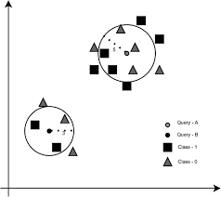


Performance and Accuracy Across Techniques
Accuracy ranges: 85%–98%
CNN’s top accuracy, but costly
PCA/LDA + k-NN effective in small scale
Texture & fusion methods balance performance
Choice depends on data & deployment constraints
Notes:
So if we compare all these approaches — CNNs win in terms of accuracy, hands down. But they’re not always the best fit if you’re limited on compute. PCA + LDA with k-NN gives you great results for small, balanced datasets. And LBP/LPQ offer that sweet middle ground — solid performance, not too heavy, and good under different lighting conditions. It really comes down to what you’re building the system for — speed, accuracy, or flexibility.”

Slide 12

Limitations and Further work
Sensitive to lighting, pose, and occlusion
Dataset imbalance affects fairness
Hybrid models aim for speed,accuracy, and fairness
Research focuses on lightweight, ethical systems
Notes:
Despite the progress, there are still key challenges. One is bias — models trained on imbalanced data can perform poorly on underrepresented groups. Another is sensitivity to lighting, pose, and occlusion, which still affect accuracy in real-world use.”
“Recent research is working on fairer training methods, smarter data augmentation, and lightweight deep models that are easier to deploy on devices with limited resources.”
“The future is moving toward systems that are not just accurate, but also inclusive, efficient, and reliable in diverse environments.”

Slide 13
THANK YOU!
Notes:
“Alright, that’s our presentation! Thanks so much for listening — we really enjoyed diving into this topic. Let us know if you have any questions or thoughts. We’d love to hear what you think.”

